Slide 1
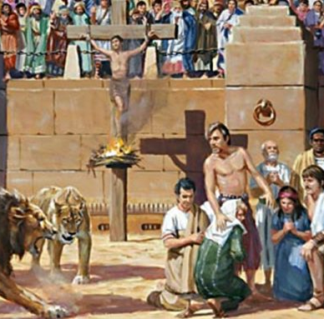
Roman persecution of Christians

Slide 2
THINK
What does it mean to persecute a group?
For what reasons have groups of people been persecuted throughout history?
What effects can persecution have on a group of people?

Slide 3
Early Christianity
Early Christians saw themselves as Jews – Jesus was the fulfilment of Jewish prophecy
Jews in Roman Empire enjoyed certain privileges
Exempt from sacrificing and praying to Roman gods
Eventually tensions began to develop between Jews and followers of Jesus
Jewish people were worried Jesus followers would jeopardise their safety with Romans
Christians also openly refuse to pray for Empire
However as new group, not afforded same privileges as Jewish people
Since the Jews constantly made disturbances at the instigation of Chrestus, he expelled them from Rome.
Suetonius, Claudius 25.4

Slide 4
Additional reasons for persecution
Openly proselytised - appeared antagonistic to Romans
Many rites performed in secret – led to accusations of incest and cannibalism
Refusal to sacrifice jeopardised safety of empire
Easy scapegoat

Slide 5
ANSWER
What caused the tensions between the Jewish and early Christian communities?
Give two reasons why the Romans persecuted Christians.
Now look at the case studies and answer the following:
What is meant by the expression ‘propitiate the gods’? Why did the Romans think that it was necessary to propitiate the gods?
What happened to the Christians under Nero?
Who was Polycarp and why was he executed?
Who was Vibia Perpetua and why was she executed?
Why did Christianity survive and, indeed, thrive despite this brutal period of persecution?

Slide 6
“The main reason that the Romans persecuted the Christians was to create a scapegoat for their own failings.” Discuss.
Introduction: State whether or not you agree with the statement, and state which reason you think is the main one.
Main Body: 2-3 PEE paragraphs, each evaluating why a particular reason is important. Use evidence from the sources to support your points.
Conclusion: Re-state whether or not you agree with the statement, and state which reason you think is the main one, explaining how you arrived at this conclusion.

